Slide 1
CEIS110 Module 6
Develop Graphical Models and Interpret Results

Slide 2
Rubric
Activity | Requirement(s) | Points
Plot #1 | Picture/screenshot of plot from data with code | 15
Plot #2 | Picture/screenshot of plot from data with code | 15
Analysis | Question, plot, and answer | 15
Prediction | Prediction based on data | 15

Slide 3
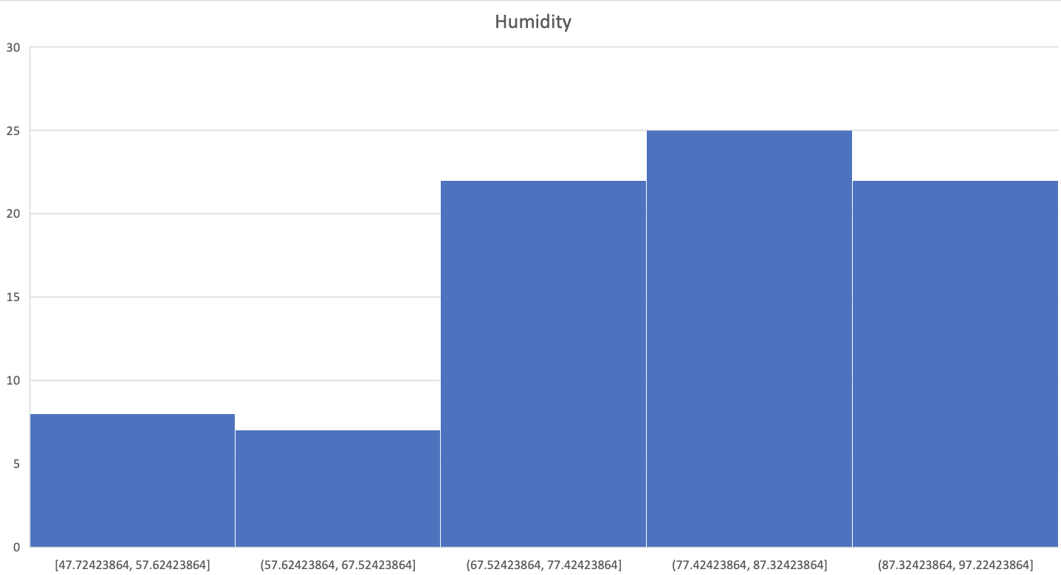
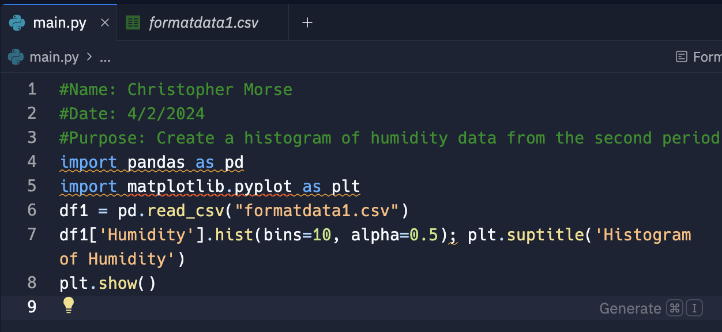
Plot #1
Plot and code used to generate it
Box
Line
Histogram
Scatter
Research your own!

Slide 4
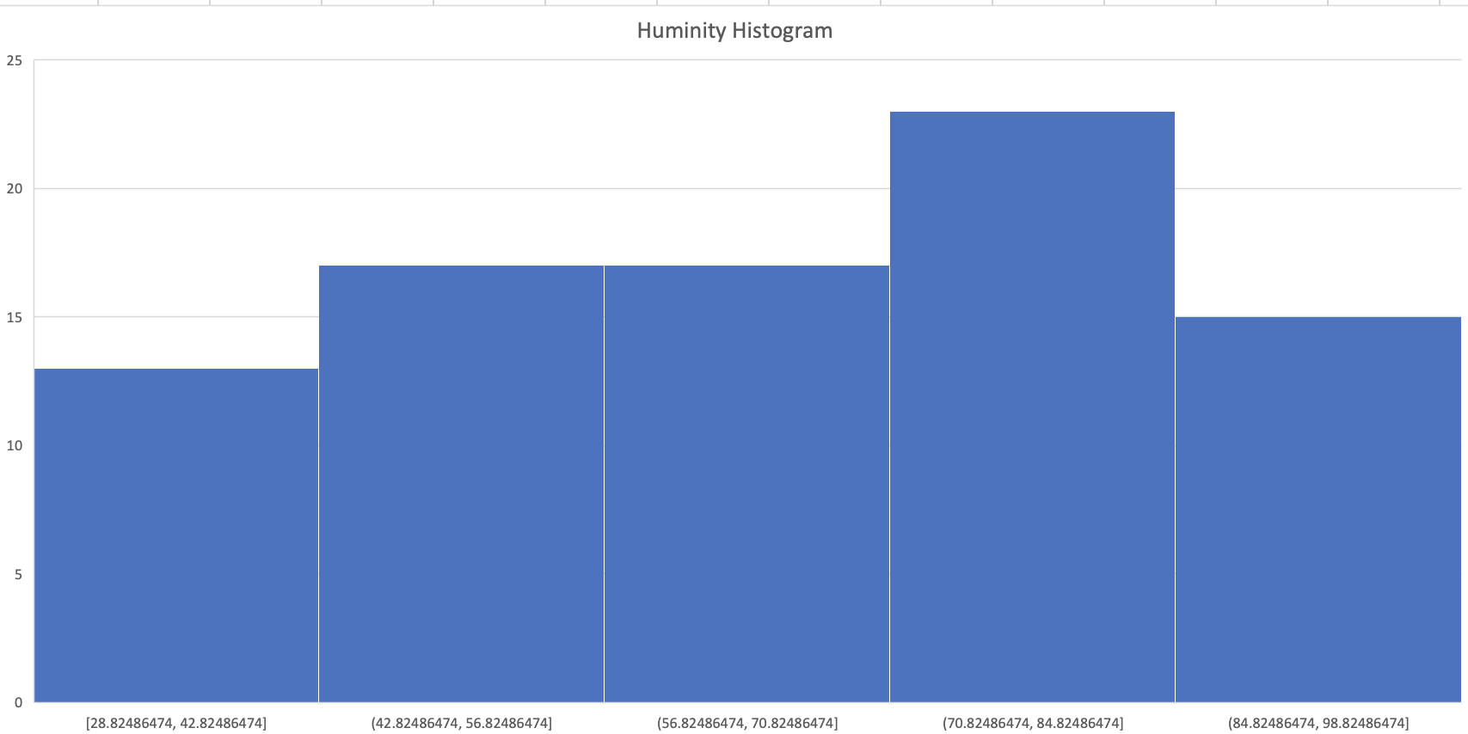
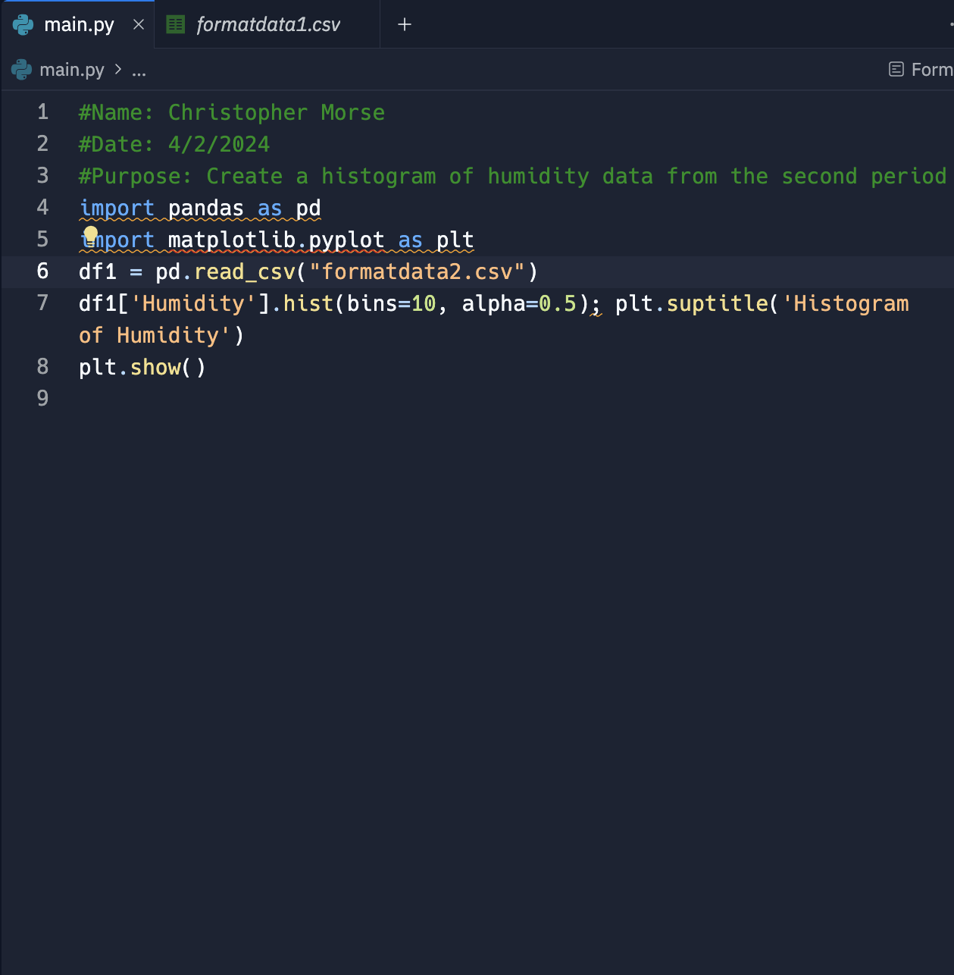
Plot #2 (Screenshots)
Plot and code used to generate it
Box
Line
Histogram
Scatter
Research your own!

Slide 5
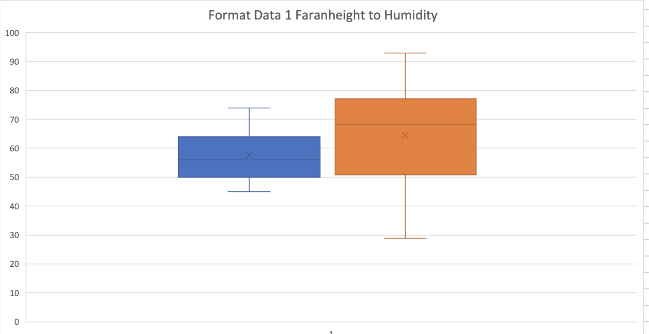
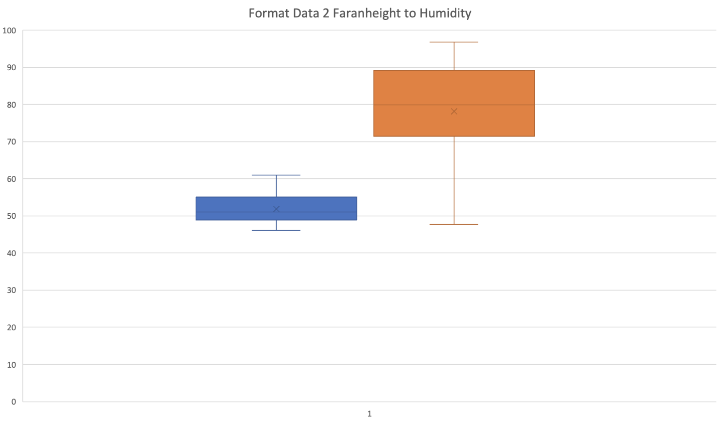
Analysis
Think of your own question and create a chart/graph to answer it
Your own question:
Given the data received is Sacramento, California getting colder or hotter throughout the month of March?
Answer supported by Chart:
While spring is coming around the corner it looks humidity went down as Fahrenheit went up throughout the month of march.

Slide 6
Prediction
Develop a prediction based on the data. What variations in temperature and humidity do you expect over the next few hours or days? How would humidity change if temperature goes up or down?
Over the next few days, my prediction would be little no no change, change is only seen in 2 week intervals pertaining to weather or how hot or how cold it is. As spring comes and we get more showers with hotter weather in Sacramento California. The humidity will be higher as spring carries on as Fahrenheit goes higher.

